Slide 1



Home
About Us
News
Gallery
Performers
Supporters
Barrier Reef Orchestra – A North Queensland Icon
Fast becoming one of North Queensland’s cultural jewels the Barrier Reef Orchestra this year launches its 15th year of performing orchestral music throughout North Queensland. A community orchestra consisting of the finest musicians drawn from as far afield as Cairns and Mackay, it focuses on unique orchestral juxtapositions. An outstanding performance of Beethoven’s 9th Symphony presented to a sell-out audience was recently followed by Peter Sculthorpe’s Mangroves, a collaboration with audio-visual artists, ABC radio and Umbrella Studios. The programs are testament to the orchestra’s willingness to embrace mainstream classical repertoire as well as opportunities for collaboration. In 2015 the orchestra has been invited to perform in three festivals, and features in the Townsville Civic Theatre season. This is a first for the orchestra - underscoring its value to the community and highlighting its continued prominence in the cultural soundscape of North Queensland.

Slide 2
Home
About Us
News
Gallery
Performers
Supporters
About Us
The Barrier Reef Orchestra is a product of North Queensland Ensembles Inc. North Queensland Ensembles Inc. is an Incorporated Association registered in the State of Queensland. It is also a tax deductible fund listed on the Register of Cultural Organisations under Subdivision 30-B of the Income tax Assessment Act 1997. It is based in Townsville, North Queensland, Australia.
North Queensland Ensembles Inc Management Committee 2015
President: | Andrew Ryder
Vice-President: | Judy Hunter
Secretary: | Lorraine Gray-McConnell
Treasurer: | Annette Ellis
Committee: | Caroline Arlett

Slide 3
Home
About Us
News
Gallery
Performers
Supporters
About Us
History
[NOTE, DROPBOX SLIDE, NO CONTENT]

Slide 4
Home
About Us
News
Gallery
Performers
Supporters
History
Over a two-year period in the late nineties, Townsville musicians, arts workers and a group of people who had a love for music realised the potential for developing a community-based Orchestra — one that would flourish and become an integral part of the City’s cultural life.
In 2000 to ‘test’ the viability of establishing an Orchestra a weekend workshop was arranged and musicians were invited to participate under the baton of Richard McIntyre, Senior Lecturer at the Canberra School of Music and the result — the Barrier Reef Orchestra was born.
During the past few years, the Orchestra has performed with the comedy-duo Scared Weird Little Guys in Score, Townsville City Council’s Last Night of the Proms and A Christmas Carol. In 2003 the Council’s centenary year the Orchestra took part in Encore, as well as playing a major role in the Townsville Civic Theatre’s 25th Anniversary productions of Noye’s Fludde and Carmina Burana.

Slide 5
Home
About Us
News
Gallery
Performers
Supporters
News
World Music Concert
As you travel the globe one of the standout features of so many different countries is undoubtedly their music. This concert saves on the shoe leather and brings an eclectic mix of music from all over the world to Townsville. A unique performance conceptualised and developed here in Townsville by the Barrier Reef Orchestra highlighting the stunning diversity of cultural music from around the globe. Featuring the Orchestra and several international artists performing music from Asia, the Americas, the British Isles, Europe and of course Australia. So pack away the passport take the trip of a life time and never leave home. Join Townsville’s very own Barrier Reef Orchestra in their 15th year for a World Music Concert.
Special guests
Adam Lopez – Developed his multi-octave, voice while studying opera in Australia more....

Slide 6
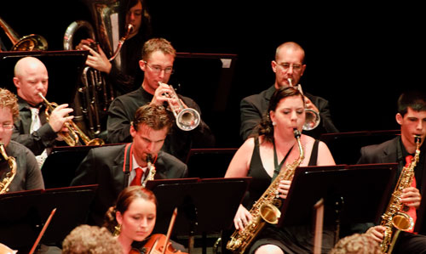
Home
About Us
News
Gallery
Performers
Supporters
Hot Summer’s Night 2008
Pictures move this way if the “forward” button is pressed
Pictures moves this way if the “back” button is pressed
<<
II
>>

Slide 7
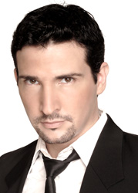
Home
About Us
News
Gallery
Performers
Supporters
Adam Lopez - Vocal
Adam Lopez’s exceptional vocal artistry has paved opportunities to perform backing vocals for some of the biggest names in the music industry such as Mariah Carey, Keith Urban and The Coors. His most recent noted collaboration was headlining with Australian Jazz legend James Morrison in a string of Symphonic Concerts in Perth, Hobart and Brisbane.
His discography includes an eclectic collection of genres spanning from Pop-Opera, Pop, Rhythm & Blues, Jazz, Power Ballads and Fiery Latin!
His phenomenal vocal range smashed two Guinness World Records (one note above the range of a piano!)

Slide 8
Home
About Us
News
Gallery
Performers
Supporters

